Slide 1
CSE 320: Linkers
Chapter 7
Professor Dan Benz

Slide 2
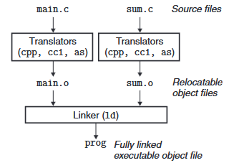
Compiler systems:
The compiler system provides a “compiler driver” which includes a pre-processor (cpp), a compiler (cc), an assembler (as), and a linker (ld).
The preprocessor translates the source code into an ASCII intermediate form (*.i)
Then the compiler translates the ASCII intermediate form into an ASCII assembly-language file (*.s)
The assembler then translates the assembly file into a relocatable object file (*.o)
Finally the linker combines all necessary object files into an executable

Slide 3
Pre-Processors, Compilers, Assemblers, and Linkers
Pre-Processors: CSE220 slides 20
  Makes code more easily modifiable/packageable for developers
Compilers: CSE 320 Chapter 5 slides
  Optimizes software and removes abstractions (memory, types, code structure)
Assemblers: CSE 220 slides ISAs
  Converts assembly to machine code (removes labels)
Linkers: Today
  Combines your code with libraries and packages it for system execution

Slide 4
Why Linkers?
Reason 1: Modularity
  Program can be written as a collection of smaller source files, rather than one monolithic mass.
  Can build libraries of common functions (more on this later)
    e.g., Math library, standard C library

Slide 5
Why Linkers? (cont)
Reason 2: Efficiency
  Time: Separate compilation
    Change one source file, compile, and then relink.
    No need to recompile other source files.
  Space: Libraries
    Common functions can be aggregated into a single file...
    Yet executable files and running memory images contain only code for the functions they actually use.

Slide 6
Linker Main Tasks:
The Linker must perform two main tasks:
Symbol resolution: This is where the symbol table from the object files are used to resolve references
Relocation: By default the compiler and assembler will assume that memory starts at address 0. The linker relocates symbols to the actual location in memory that the instructions and data will be located at.

Slide 7
Symbol resolution
Step 1: Symbol resolution
  Programs define and reference symbols (global variables and functions):
    void swap() {…} /* define symbol swap */
    swap(); /* reference symbol swap */
    int *xp = &x; /* define symbol xp, reference x */
  Symbol definitions are stored in object file (by assembler) in symbol table.
    Symbol table is an array of structs
    Each entry includes name, size, and location of symbol.
  During symbol resolution step:
    the linker associates each symbol reference with exactly one symbol definition.

Slide 8
Relocation
Step 2: Relocation
  Merges separate code and data sections into single sections
  Relocates symbols from their relative locations in the .o files to their final absolute memory locations in the executable.
  Updates all references to these symbols to reflect their new positions.
Let’s look at these two steps in more detail….

Slide 9
Three Kinds of Object Files (Modules)
Relocatable object file (.o file)
  Contains code and data in a form that can be combined with other relocatable object files to form executable object file.
    Each .o file is produced from exactly one source (.c) file
Executable object file (a.out file)
  Contains code and data in a form that can be copied directly into memory and then executed.
Shared object file (.so file)
  Special type of relocatable object file that can be loaded into memory and linked dynamically, at either load time or run-time.
  Called Dynamic Link Libraries (DLLs) by Windows

Slide 10


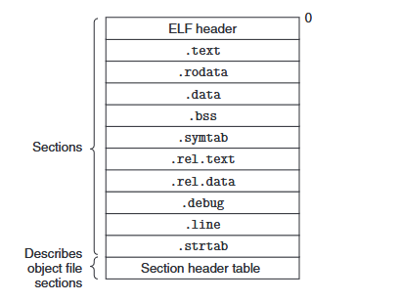
Executable and Linkable Format (ELF)
Standard binary format for object files
One unified format for
  Relocatable object files (.o),
  Executable object files (a.out)
  Shared object files (.so)
Generic name: ELF binaries

Slide 11
ELF Object File Format
Elf header
  Word size, byte ordering, file type (.o, exec, .so), machine type, etc.
Segment header table
  Page size, virtual addresses memory segments (sections), segment sizes.
.text section
  Code
.rodata section
  Read only data: jump tables, ...
.data section
  Initialized global variables
.bss section
  Uninitialized global variables
  “Block Started by Symbol”
  “Better Save Space”
  Has section header but occupies no space
0
ELF header
Segment header table
(required for executables)
.text section
.rodata section
.data section
.bss section
.symtab section
.rel.txt section
.rel.data section
.debug section
Section header table

Slide 12
ELF Object File Format (cont.)
.symtab section
  Symbol table
  Procedure and static variable names
  Section names and locations
.rel.text section
  Relocation info for .text section
  Addresses of instructions that will need to be modified in the executable
  Instructions for modifying.
.rel.data section
  Relocation info for .data section
  Addresses of pointer data that will need to be modified in the merged executable
.debug section
  Info for symbolic debugging (gcc -g)
Section header table
  Offsets and sizes of each section
0
ELF header
Segment header table
(required for executables)
.text section
.rodata section
.data section
.bss section
.symtab section
.rel.txt section
.rel.data section
.debug section
Section header table

Slide 13
Linker Symbols
Global symbols
  Symbols defined by module m that can be referenced by other modules.
  E.g.: non-static C functions and non-static global variables.
External symbols
  Global symbols that are referenced by module m but defined by some other module.
Local symbols
  Symbols that are defined and referenced exclusively by module m.
  E.g.: C functions and global variables defined with the static attribute.
  Local linker symbols are not local program variables

Slide 14

Step 1: Symbol Resolution
int sum(int *a, int n);
int array[2] = {1, 2};
int main()
{
int val = sum(array, 2);
return val;
}
int sum(int *a, int n)
{
int i, s = 0;
for (i = 0; i < n; i++) {
s += a[i];
}
return s;
}

Slide 15
Local Symbols
Local non-static C variables vs. local static C variables
  local non-static C variables: stored on the stack
  local static C variables: stored in either .bss, or .data
int f() {
static int x = 0; return x;
}
int g() {
static int x = 1; x++;
return x;
}
Compiler allocates space in .data for each definition of x
Creates local symbols in the symbol table with unique names, e.g., x.1 and x.2.

Slide 16
How Linker Resolves Duplicate Symbol Definitions
Program symbols are either strong or weak
  Strong: procedures and initialized globals
  Weak: uninitialized globals
strong
int foo=5;
p1() {}
short foo;
p2() {}
weak
strong
strong

Slide 17
Linker’s Symbol Rules
Rule 1: Multiple strong symbols are not allowed
  Each item can be defined only once
  Otherwise: Linker error
Rule 2: Whenever possible: choose the strong symbol
  References to the weak symbol resolve to the strong symbol
Rule 3: If there are multiple weak symbols, pick an arbitrary one
  Can override this with gcc –fno-common

Slide 18
Linker Puzzles
int x;
p1() {}
p1() {}
Link time error: two strong symbols (p1)
int x;
p1() {}
int x;
p2() {}
References to x will refer to the same
uninitialized int. Is this what you really want?
int x, y;
p1() {}
double x;
p2() {}
Writes to x in p2 might overwrite y!
Evil!
int x=7,y=5;
p1() {}
double x;
p2() {}
Writes to x in p2 will overwrite y!
Nasty!
int x=7;
p1() {}
int x;
p2() {}
References to x will refer to the same initialized
variable.
Nightmare scenario: two identical weak structs, compiled by different compilers
with different alignment rules.

Slide 19
Global Variables
Avoid if you can
Otherwise
  Use static if you can
  Initialize if you define a global variable
  Use extern if you reference an external global variable
    Use a header file to handle global declarations to avoid type mismatches

Slide 20
Linker Relocation:
Once the linker has resolved all the symbols it must relocate the object files into one ELF file. This is done in two steps:
  1) Relocating Sections: All .data, .txt, .bss, etc. sections need to be aggregated and references to the sections need to be updated
  2) Relocating symbol references within sections: The references to specific symbols within the sections need to be updated

Slide 21
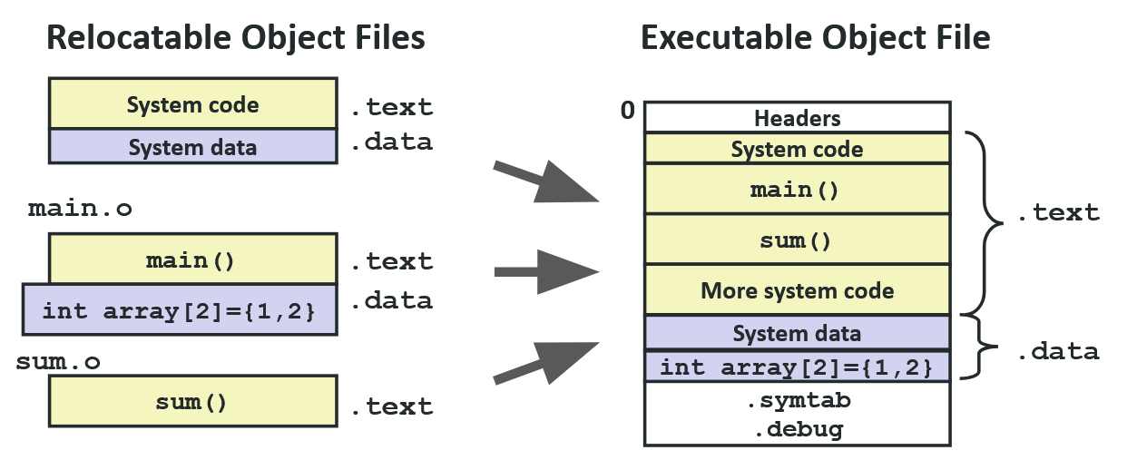
Step 2: Relocation

Slide 22
Relocation Entries
int array[2] = {1, 2};
int main()
{
int val = sum(array, 2);
return val;
}
Source: objdump –r –d main.o
0000000000000000 <main>:
0: 48 83 ec 08 sub $0x8,%rsp
4: be 02 00 00 00 mov $0x2,%esi
9: bf 00 00 00 00 mov $0x0,%edi # %edi = &array
a: R_X86_64_32 array # Relocation entry
e: e8 00 00 00 00 callq 13 <main+0x13> # sum()
f: R_X86_64_PC32 sum-0x4 # Relocation entry
13: 48 83 c4 08 add $0x8,%rsp
17: c3 retq

Slide 23
Relocated .text section
Source: objdump -dx prog
00000000004004d0 <main>:
4004d0: 48 83 ec 08 sub $0x8,%rsp
4004d4: be 02 00 00 00 mov $0x2,%esi
4004d9: bf 18 10 60 00 mov $0x601018,%edi # %edi = &array
4004de: e8 05 00 00 00 callq 4004e8 <sum> # sum()
4004e3: 48 83 c4 08 add $0x8,%rsp
4004e7: c3 retq
00000000004004e8 <sum>:
4004e8: b8 00 00 00 00 mov $0x0,%eax
4004ed: ba 00 00 00 00 mov $0x0,%edx
4004f2: eb 09 jmp 4004fd <sum+0x15>
4004f4: 48 63 ca movslq %edx,%rcx
4004f7: 03 04 8f add (%rdi,%rcx,4),%eax
4004fa: 83 c2 01 add $0x1,%edx
4004fd: 39 f2 cmp %esi,%edx
4004ff: 7c f3 jl 4004f4 <sum+0xc>
400501: f3 c3 repz retq
Using PC-relative addressing for sum(): 0x4004e8 = 0x4004e3 + 0x5

Slide 24
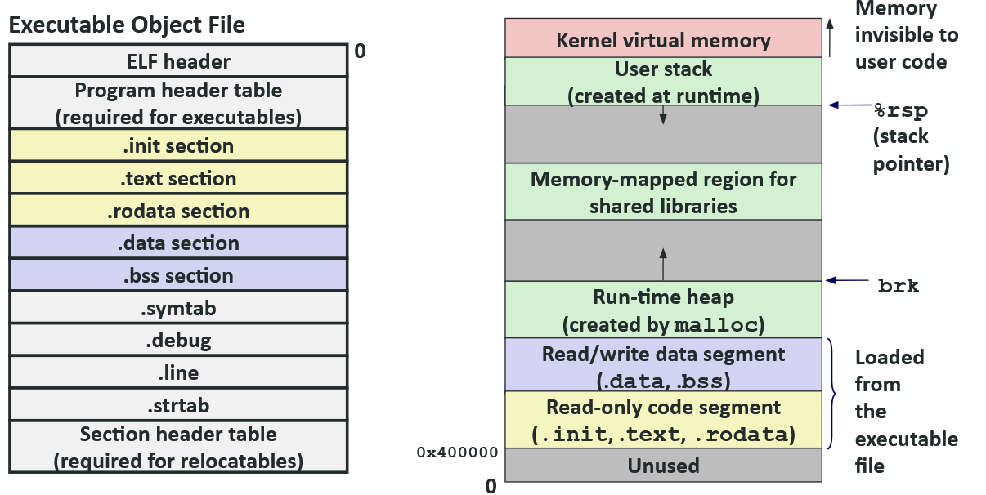
Loading Executable Object Files

Slide 25
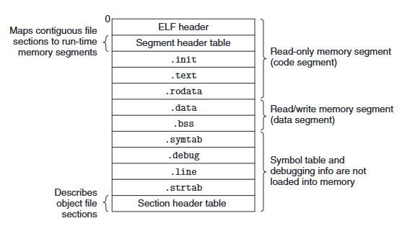
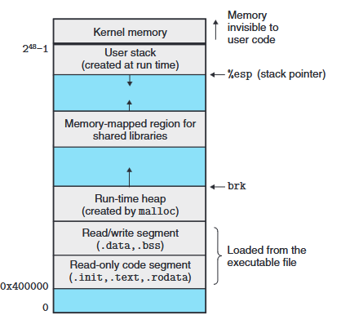

How to run an ELF?
Executable Object Files also contain an .init segment that tells you where (and how) to begin execution of the .text segment.
Notice that not all of the ELF is writable and not all of the ELF is loaded into memory to begin execution.

Slide 26
Packaging Commonly Used Functions
How to package functions commonly used by programmers?
  Math, I/O, memory management, string manipulation, etc.
Awkward, given the linker framework so far:
  Option 1: Put all functions into a single source file
    Programmers link big object file into their programs
    Space and time inefficient
  Option 2: Put each function in a separate source file
    Programmers explicitly link appropriate binaries into their programs
    More efficient, but burdensome on the programmer

Slide 27
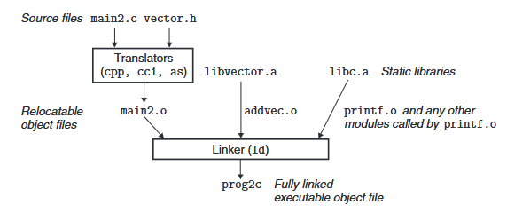
Linking C lib:
How can the linker add calls to system library functions without including the whole library in every elf?
C libraries are often stored in the archive (*.a) format.
When the linker encounters a reference to a symbol that it doesn’t have, it checks the static libraries installed in the system and copies over only the object files from the needed symbols.

Slide 28
Old-fashioned Solution: Static Libraries
Static libraries (.a archive files)
  Concatenate related relocatable object files into a single file with an index (called an archive).
  Enhance linker so that it tries to resolve unresolved external references by looking for the symbols in one or more archives.
  If an archive member file resolves reference, link it into the executable.

Slide 29
Creating Static Libraries
atoi.c
printf.c
random.c
Translator
Translator
...
Translator
atoi.o
printf.o
random.o
Archiver (ar)
unix> ar rs libc.a \
atoi.o printf.o … random.o
libc.a
C standard library
Archiver allows incremental updates
Recompile function that changes and replace .o file in archive.

Slide 30
Commonly Used Libraries
% ar –t libc.a | sort
…
fork.o
…
fprintf.o
fpu_control.o
fputc.o
freopen.o
fscanf.o
fseek.o
fstab.o
…
libc.a (the C standard library)
  4.6 MB archive of 1496 object files.
  I/O, memory allocation, signal handling, string handling, data and time, random numbers, integer math
libm.a (the C math library)
  2 MB archive of 444 object files.
  floating point math (sin, cos, tan, log, exp, sqrt, …)
% ar –t libm.a | sort
…
e_acos.o
e_acosf.o
e_acosh.o
e_acoshf.o
e_acoshl.o
e_acosl.o
e_asin.o
e_asinf.o
e_asinl.o
…

Slide 31
Linking with Static Libraries
libvector.a
#include <stdio.h>
#include "vector.h"
int x[2] = {1, 2};
int y[2] = {3, 4};
int z[2];
int main()
{
addvec(x, y, z, 2);
printf("z = [%d %d]\n”,
z[0], z[1]);
return 0;
}
void addvec(int *x, int *y, int *z, int n) {
int i;
for (i = 0; i < n; i++)
z[i] = x[i] + y[i];
}
void multvec(int *x, int *y, int *z, int n)
{
int i;
for (i = 0; i < n; i++)
z[i] = x[i] * y[i];
}

Slide 32
Linking with Static Libraries (visual)
addvec.o
multvec.o
main2.c
vector.h
Archiver
(ar)
Translators
(cpp, cc1, as)
libc.a
Static libraries
libvector.a
Relocatable
object files
main2.o
addvec.o
printf.o and any other
modules called by printf.o
Linker (ld)
Fully linked
executable object file
prog2c
“c” for “compile-time”

Slide 33
Using Static Libraries
Linker’s algorithm for resolving external references:
  Scan .o files and .a files in the command line order.
  During the scan, keep a list of the current unresolved references.
  As each new .o or .a file, obj, is encountered
    try to resolve each unresolved reference in the list against the symbols defined in obj.
  If any entries in the unresolved list at end of scan, then error.
Problem:
  Command line order matters!
  Moral: put libraries at the end of the command line.
unix> gcc -L. libtest.o -lmine
unix> gcc -L. -lmine libtest.o
libtest.o: In function `main':
libtest.o(.text+0x4): undefined reference to `libfun'

Slide 34
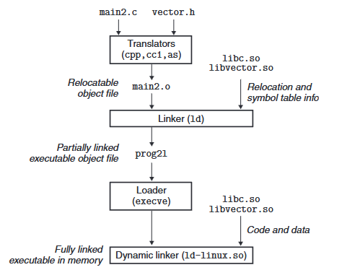
Dynamic Linking:
Since almost every program uses printf, isn’t it wasteful to include that object file in every ELF?
  Yes, “Shared Libraries” allow for a process called “Dynamic linking”.
  This process uses a different kind of object called a shared object (*.so)
    Windows uses this feature a lot with their Dynamically Linked Libraries (DLLs)

Slide 35
Modern Solution: Shared Libraries
Static libraries have the following disadvantages:
  Duplication in the stored executables (every function needs libc)
  Duplication in the running executables
  Minor bug fixes of system libraries require each application to explicitly relink
Modern solution: Shared Libraries
  Object files that contain code and data are
    loaded and linked into an application dynamically, at either load-time or run-time
  Also called: dynamic link libraries, DLLs, .so files

Slide 36
Shared Libraries (cont.)
Dynamic linking can occur when executable is loaded and run
  load-time linking
  Common case for Linux, handled automatically by the dynamic linker (ld-linux.so).
  Standard C library (libc.so) usually dynamically linked.
Dynamic linking can occur after program has begun (run-time linking).
  In Linux, this is done by calls to the dlopen() interface.
    Distributing software.
    High-performance web servers.
    Runtime library interpositioning.
Shared library routines can be shared by multiple processes.
  More on this when we learn about virtual memory

Slide 37
Dynamic Linking at Load-time
main2.c
vector.h
unix> gcc -shared -o libvector.so \
addvec.c multvec.c
Translators
(cpp, cc1, as)
libc.so
libvector.so
Relocatable
object file
main2.o
Relocation and symbol table info
Linker (ld)
Partially linked
executable object file
prog2l
Loader (execve)
libc.so
libvector.so
Code and data
Fully linked
executable
in memory
Dynamic linker (ld-linux.so)

Slide 38
Dynamic Linking at Run-time
#include <stdio.h>
#include <stdlib.h>
#include <dlfcn.h>
int x[2] = {1, 2}; int y[2] = {3, 4}; int z[2];
int main()
{
void *handle; void (*addvec)(int *, int *, int *, int); char *error;
/* Dynamically load the shared library that contains addvec() */
handle = dlopen("./libvector.so", RTLD_LAZY);
if (!handle) { fprintf(stderr, "%s\n", dlerror()); exit(1); }
/* Get a pointer to the addvec() function we just loaded */
addvec = dlsym(handle, "addvec");
if ((error = dlerror()) != NULL) { fprintf(stderr, "%s\n", error); exit(1); }
/* Now we can call addvec() just like any other function */
addvec(x, y, z, 2); printf("z = [%d %d]\n", z[0], z[1]);
/* Unload the shared library */
if (dlclose(handle) < 0) { fprintf(stderr, "%s\n", dlerror()); exit(1); }
return 0;
}

Slide 39
Linking Summary
Linking is a technique that allows programs to be constructed from multiple object files.
Linking can happen at different times in a program’s lifetime:
  Compile time (when a program is compiled)
  Load time (when a program is loaded into memory)
  Run time (while a program is executing)
Understanding linking can help you avoid nasty errors and make you a better programmer.

Slide 40
Position Independent Code:
The compiler flag “fpic” can be used to specify that you want your code to be compiled and linked without relying on the ELF starting at address 0x0.
This makes your code larger and potentially slower but it means that you can create a system object that can be dynamic linked outside of your program’s ELF file.
This has the advantage of being able to skip the “relocation” passes and allows programs to be loaded at arbitrary memory locations.
  Modern operating systems have a mechanism that allows all programs to think they are at address 0x0, so this is unnecessary.

Slide 41
Case Study: Library Interpositioning
Library interpositioning : powerful linking technique that allows programmers to intercept calls to arbitrary functions
Interpositioning can occur at:
  Compile time: When the source code is compiled
  Link time: When the relocatable object files are statically linked to form an executable object file
  Load/run time: When an executable object file is loaded into memory, dynamically linked, and then executed.

Slide 42
Some Interpositioning Applications
Security
  Confinement (sandboxing)
  Behind the scenes encryption
Debugging
  In 2014, Facebook engineers found a 1-year old bug in their iPhone app using interpositioning
  Code in the SPDY networking stack was writing to the wrong location
  Solved by intercepting calls to Posix write functions (write, writev, pwrite)
  Source: Facebook engineering blog post at
  https://code.facebook.com/posts/313033472212144/debugging-file-corruption-on-ios/

Slide 43
More Interpositioning Applications
Monitoring and Profiling
  Count number of calls to functions
  Characterize call sites and arguments to functions
  Malloc tracing
    Detecting memory leaks
    Generating address traces

Slide 44
Example program
Goal: trace the addresses and sizes of the allocated and freed blocks, without breaking the program, and without modifying the source code.
Three solutions: interpose on the lib malloc and free functions at compile time, link time, and load/run time.
#include <stdio.h>
#include <malloc.h>
int main()
{
int *p = malloc(32);
free(p);
return(0);
}

Slide 45
Compile-time Interpositioning (code)
#ifdef COMPILETIME
#include <stdio.h>
#include <malloc.h>
/* malloc wrapper function */
void *mymalloc(size_t size)
{
void *ptr = malloc(size); printf("malloc(%d)=%p\n", (int)size, ptr);
return ptr;
}
/* free wrapper function */
void myfree(void *ptr)
{ free(ptr); printf("free(%p)\n", ptr); }
#endif

Slide 46
Compile-time Interpositioning
#define malloc(size) mymalloc(size)
#define free(ptr) myfree(ptr)
void *mymalloc(size_t size);
void myfree(void *ptr);
linux> make intc
gcc -Wall -DCOMPILETIME -c mymalloc.c
gcc -Wall -I. -o intc int.c mymalloc.o
linux> make runc
./intc
malloc(32)=0x1edc010
free(0x1edc010)
linux>

Slide 47
Link-time Interpositioning (code)
#ifdef LINKTIME
#include <stdio.h>
void *__real_malloc(size_t size);
void __real_free(void *ptr);
/* malloc wrapper function */
void *__wrap_malloc(size_t size)
{
void *ptr = __real_malloc(size); /* Call libc malloc */
printf("malloc(%d) = %p\n", (int)size, ptr); return ptr;
}
/* free wrapper function */
void __wrap_free(void *ptr)
{ __real_free(ptr); /* Call libc free */ printf("free(%p)\n", ptr);}
#endif

Slide 48
Link-time Interpositioning
linux> make intl
gcc -Wall -DLINKTIME -c mymalloc.c
gcc -Wall -c int.c
gcc -Wall -Wl,--wrap,malloc -Wl,--wrap,free -o intl int.o mymalloc.o
linux> make runl
./intl
malloc(32) = 0x1aa0010
free(0x1aa0010)
The “-Wl” flag passes argument to linker, replacing each comma with a space.
The “--wrap,malloc ” arg instructs linker to resolve references in a special way:
  Refs to malloc should be resolved as __wrap_malloc
  Refs to __real_malloc should be resolved as malloc

Slide 49
Load/Run-time Interpositioning (code)
#ifdef RUNTIME
#define _GNU_SOURCE
#include <stdio.h>
#include <stdlib.h>
#include <dlfcn.h>
/* malloc wrapper function */
void *malloc(size_t size)
{
void *(*mallocp)(size_t size); char *error;
mallocp = dlsym(RTLD_NEXT, "malloc"); /* Get addr of libc malloc */
if ((error = dlerror()) != NULL) { fputs(error, stderr); exit(1); }
char *ptr = mallocp(size); /* Call libc malloc */
printf("malloc(%d) = %p\n", (int)size, ptr);
return ptr;
}

Slide 50
Load/Run-time Interpositioning (free code)
/* free wrapper function */
void free(void *ptr)
{
void (*freep)(void *) = NULL;
char *error;
if (!ptr) return;
freep = dlsym(RTLD_NEXT, "free"); /* Get address of libc free */
if ((error = dlerror()) != NULL) { fputs(error, stderr); exit(1); }
freep(ptr); /* Call libc free */
printf("free(%p)\n", ptr);
}
#endif

Slide 51
Load/Run-time Interpositioning
linux> make intr
gcc -Wall -DRUNTIME -shared -fpic -o mymalloc.so mymalloc.c -ldl
gcc -Wall -o intr int.c
linux> make runr
(LD_PRELOAD="./mymalloc.so" ./intr)
malloc(32) = 0xe60010
free(0xe60010)
linux>

Slide 52
Interpositioning Recap
Compile Time
  Apparent calls to malloc/free get macro-expanded into calls to mymalloc/myfree
Link Time
  Use linker trick to have special name resolutions
    malloc 🡪 __wrap_malloc
    __real_malloc 🡪 malloc
Load/Run Time
  Implement custom version of malloc/free that use dynamic linking to load library malloc/free under different names

